Slide 1
Image Encryption using Java
“Develop an application that encrypts the image.”
GUI developed in NetBeans
Stand-alone Client app - No database
SHA-512 hash of user supplied password.
Minimum password requirements implemented.
Must also decrypt
Krzysztof Pawlik x16138147
David Harrop x03298051

Slide 2
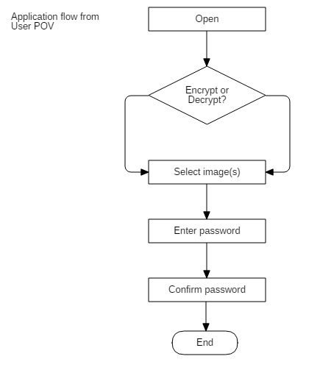
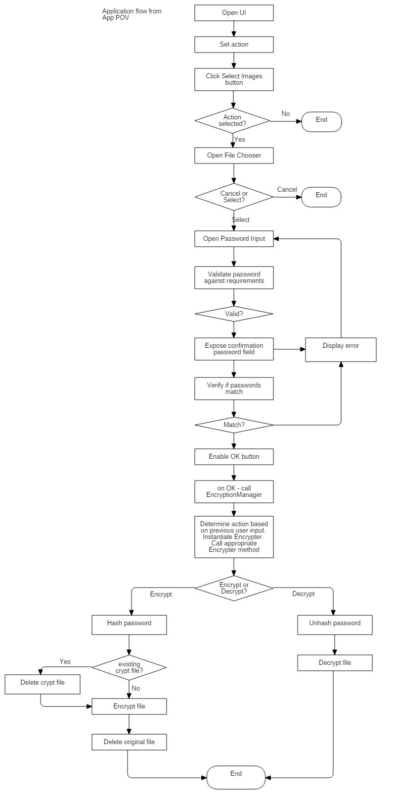
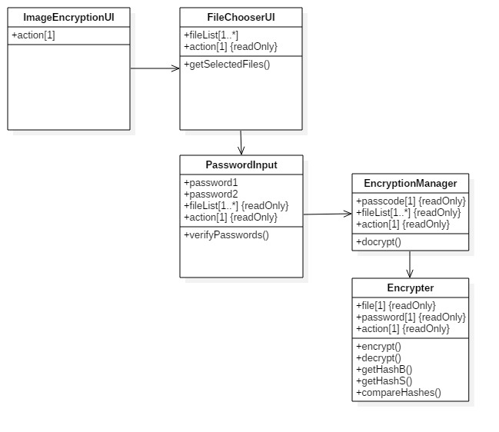

Slide 3
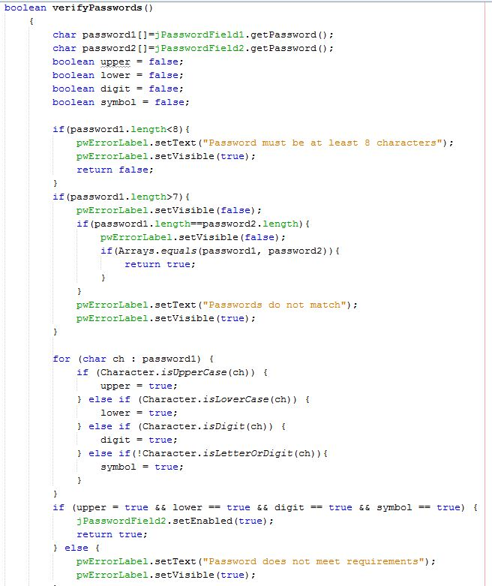
Code snippet – password verification

Slide 4
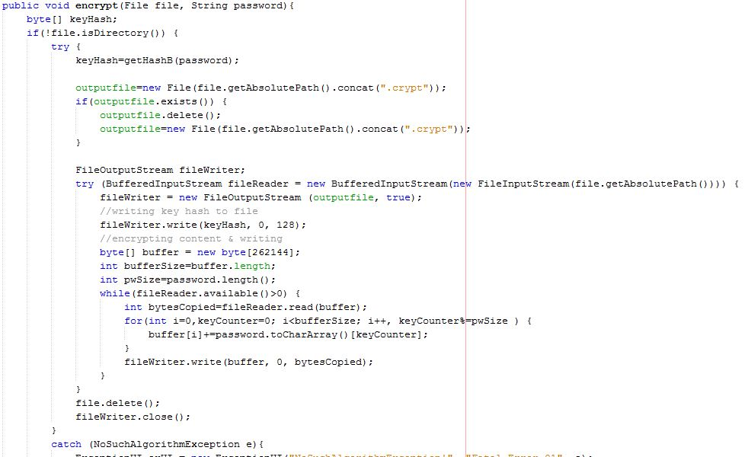
Code snippet – encryption method

Slide 5
How it works
1. Hash the password
Password
Encode in bytes
Hash encoded byte password using MessageDigest class
Creates 256 bit byte array
2. Create the encrypted file
Create new, empty output file (FileOutputStream)
Use hashed password as first 128 chars
Read input file into byte array using BufferedInputStream
Write byte array to output file
Save output file with .crypt extension
Delete input file
Limiting file type
Exceptions

